Slide 1
Beyond Words every brain deserves to understand the world
TEAM NAME : VISIONX
TEAM MEMBERS : 1.HEMASRI
2.VISMAYA COLLEGE NAME : JNTUH

Slide 2
“Raed tihs snetecne fasetr tahn you tnihk”

Slide 3


ISHAAN The problem isn’t the reader. It’s the format.

Slide 4

Problem statement 1.current situation
• Most websites present information as dense blocks of text • Pages are filled with ads, sidebars, and visual clutter

Slide 5
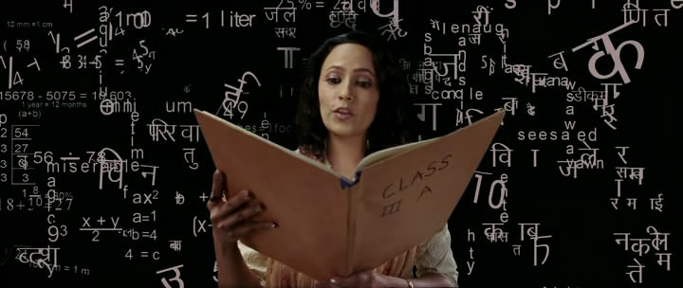
Problem statement 2 the challenge
Readers with ADHD and Dyslexia struggle to maintain focus
Words blend together, lines get skipped, and reading becomes exhausting

Slide 6
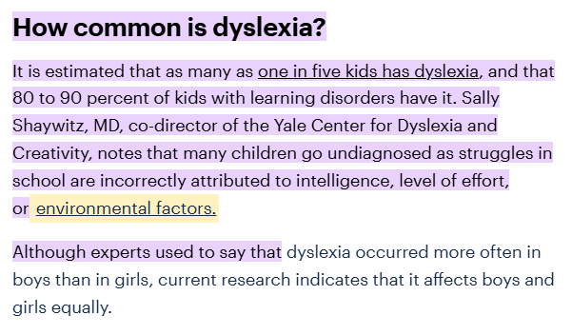
Problem statement 3.the reality
Nearly 1 in 5 people experience learning differences affecting reading
Research by childmind.org

Slide 7
Tech stack
HTML
CSS
JS
Gemini API key
Chrome Extension API
CSS Injection
DOM Manipulation

Slide 8
Our solution
FOCUS MODE
READ ALOUD
Bionic reading
AI SUMMARY
Distraction-Free View
Audio-Assisted Reading
Eye-Guided Reading
Instant Page Summary

Slide 9
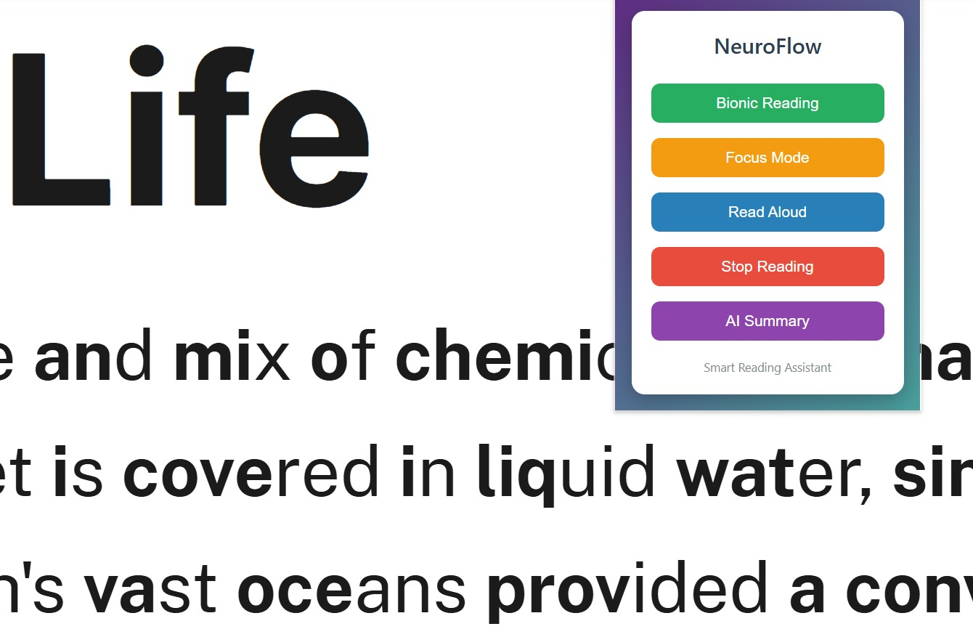
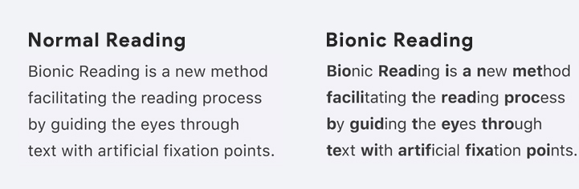
Our solution
Bionic reading
Applies Bionic Reading by highlighting the first half of words for better
eye guidance.

Slide 10
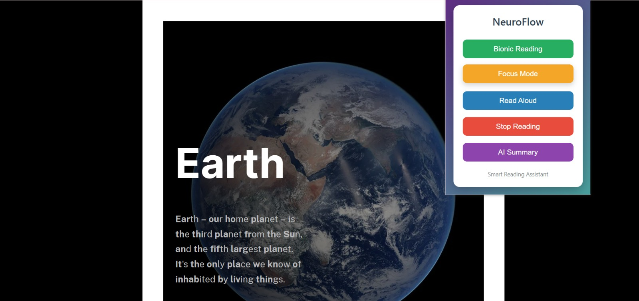
Our solution
FOCUS MODE
Provides Focus Mode to remove ads, sidebars, and visual distractions.

Slide 11

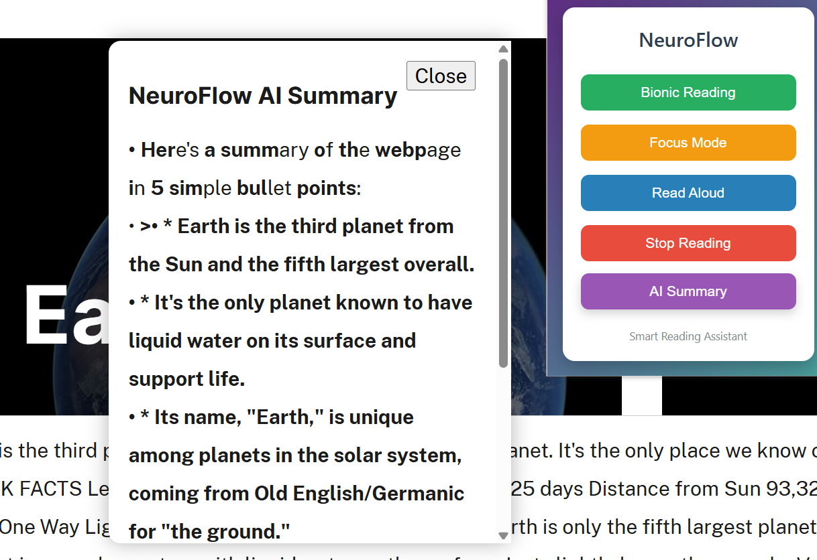
Our solution
AI SUMMARY
Uses AI Summarization to convert long articles into 5 simple bullet points.

Slide 12
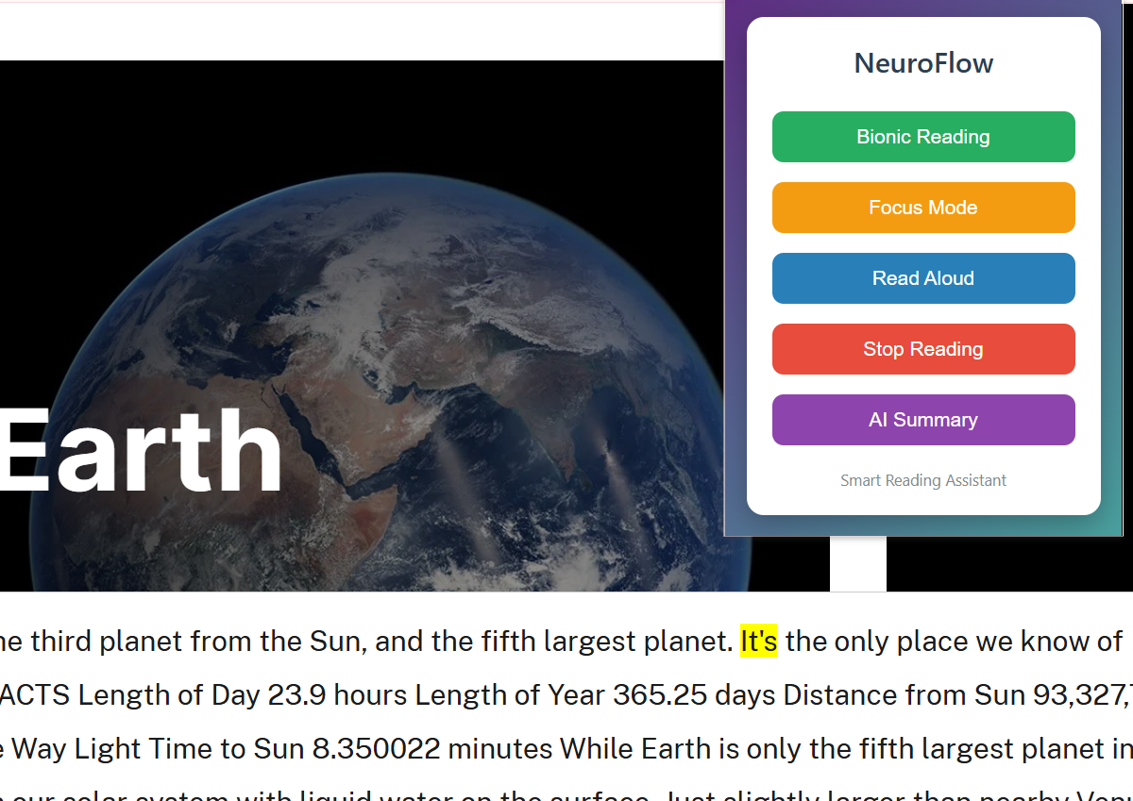
Creativity
READ ALOUD
Adds Read Aloud Assistance with word-level highlighting during speech.

Slide 13
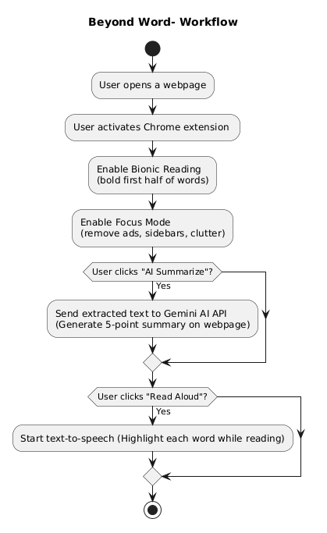
Work flow

Slide 14
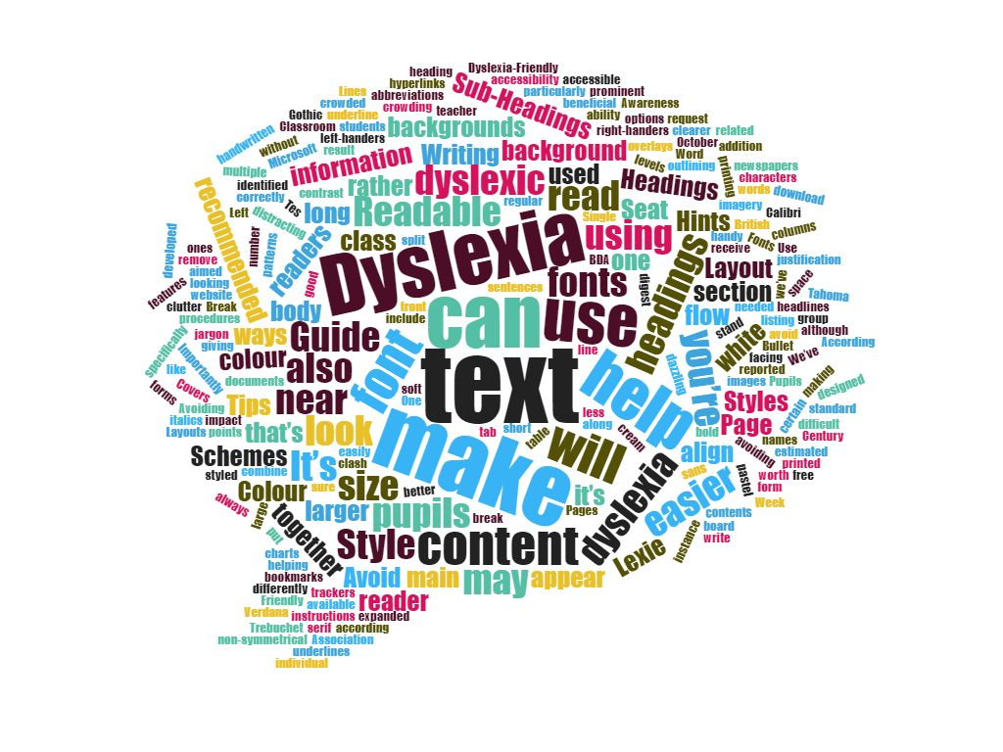
Future Enhancements
Dyslexia-friendly fonts and color themes
Mobile Browser Support
Learning Platform Integration

Slide 15
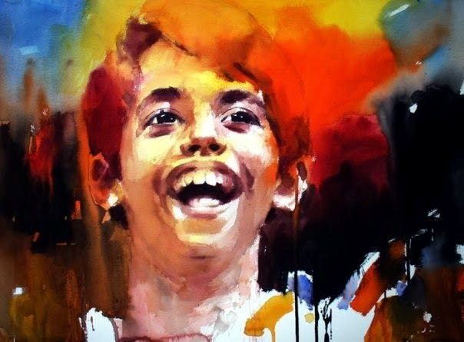
When the world learns to read every mind, every Ishaan gets the chance to shine.

